Slide 1
Longest Increasing Subsequences in Sliding Windows
Michael H. Albert, Alexander Golynski, Angele M. Hamel,
Alejandro Lopez-Ortiz, S. Srinivasa Rao, Mohammad Ali Safari, Theoretical Computer Science, Vol. 321, pp.405~414, 2004.
Presenter: Zhi-Cheng Shen
Date: Mar.07, 2023

Slide 2
Abstract
We consider the problem of finding the longest increasing subsequence in a sliding window over a given sequence (LISW). We propose an output-sensitive data structure that solves this problem in time
O(nloglogn+OUTPUT) for a sequence of n elements. This data structure substantially improves over the naive generalization of the longest increasing subsequence algorithm and in fact produces an output-sensitive optimal solution.

Slide 3
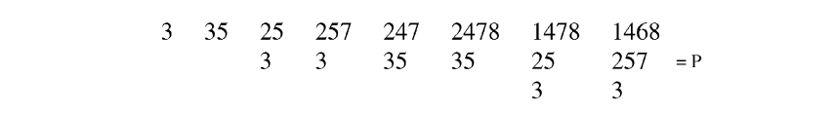
Robinson–Schensted–Knuth algorithm
list = 35274816

Slide 4
Row Towers
window: 2 5 7 3 6 8 → 5 7 3 6 8 2
R: 2 3 6 8(1) → 2 6 8(3)
3 6 8 (3) 2 8 (1)
68 (1) 2 (2)
8 (1)
d = 1 4 5 6
-2 : 3 4 5 → R: 3 6 8
+2: 6 3 4
d(i_{t+1}) = d(i_{t}) for t = 1, 2, …,k − 1;
d(i₁) = w;
此方法的data structure並沒有儲存row towers, 而是儲存R 和 d.

Slide 5
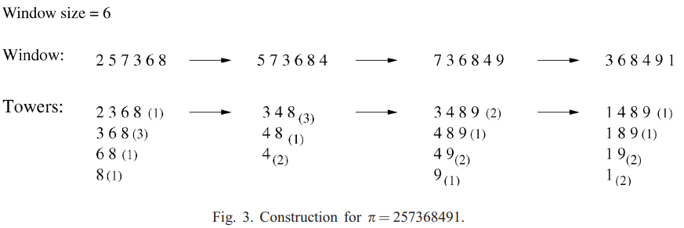
Row Towers
d = 1 4 5 6 → d = 3 6 4 → d = 2 5 3 6
-2: 3 4 5 -5: 2 5 3 -7: 1 4 2 5
+4: 3 6 4 +9 : 2 5 3 6 +1: 6 1 2 4

Slide 6
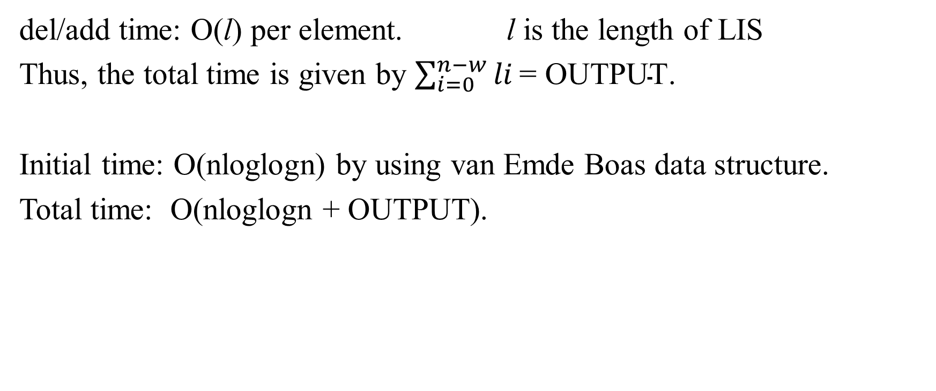
Time Complexity
del/add time: O(l) per element. l is the length of LIS
Thus, the total time is given by $\sum_{i=0}^{n−w}{li}\text{= }\text{OUTPUT}$.
Initial time: O(nloglogn) by using van Emde Boas data structure.
Total time: O(nloglogn + OUTPUT).

Slide 7
Thanks~

